Slide 1
Owning the rubric in first year at UTS
Title: Owning the rubric: Student engagement in rubric design, use and moderation
ID: ID16-5374 Program: Innovation and Development Grants Value: OLT funding is $202,000 + Institutional inputs of $350,000.
The total project budget runs $552,000.

Slide 2
The OLT grant team (2016)
A team of 10 cross-institutional academics
Avondale College of Higher Education is the lead university, with 8 members
Charles Sturt with one member
UTS with one member

Slide 3
The proposal
The central objective is to develop ways that student learning can be enhanced through the medium of assessment rubrics.
Little research has focused on the role of rubrics in student learning and, in particular, student engagement in assessment by involving them in assessment design.
Academic staff often construct rubrics from their own viewpoint because they know what they mean by particular assessment criteria and standards, but students are not so clear as to exactly what is required for assessment tasks.

Slide 4
Research questions
Phases 1 & 2 | Effective rubrics | Q1 What are the characteristics of effective rubrics?
Phase 3 | Collaborative rubric construction, use and moderation | Q2 How can students and teachers co-construct and plan the collaborative use of rubrics for student learning?
Phases 3 & 4 | Effect of collaborative rubric construction on student learning | Q3 What effect does the co-construction and use of rubrics have on students’ and lecturers’ perceptions of student learning?
Phase 4 | Model of collaborative rubric construction, use and moderation | Q4 What practical, research-informed recommendations can be used to engage students and academic staff in the collaborative process of designing, using and moderating assessment rubrics to promote learning?

Slide 5
Owning the rubric at UTS
research conducted within a first year Creative Writing mandatory unit, Imagining the Real (54071)
well before semester 2 began, an EoI was sent to every student in the cohort
the initial response solid: 12 students showed interest
by the time we got down to setting dates, there were six students
one more subsequently could not make a crucial meeting
the UTS team was five first year students

Slide 6
Assessment

Slide 7
Time
there were four meetings throughout semester
The first: another team member came to UTS for the initial introduction to project; collecting consent; initial survey; answering questions
The second: I met with students and co-construction began
The third: another team member came to UTS to collect data ie survey responses and recorded interview about the con-construction phase and before final submission; I was also interviewed
The fourth: another team member came to UTS to collect data ie survey response and recorded interview; after assessment submission; I was also interviewed

Slide 8
UTS Online
I created a forum on UTS Online where I uploaded materials to go through with the students.
It was really important to me that they understood how we arrive at our criteria, so went through AQF (Australian Qualifications Framework), The university’s Course Intended Learning Outcomes (CILOs) and the Subject Learning Outcomes (SLOs)
https://online.uts.edu.au/webapps/blackboard/content/listContentEditable.jsp?content_id=_2418509_1&course_id=_32609_1&mode=reset

Slide 9
Rubric Types
Holistic rubrics
single criteria rubrics (one-dimensional) used to assess participants' overall achievement on an activity or item based on predefined achievement levels;
performance descriptions are written in paragraphs and usually in full sentences.
Analytic rubrics
two-dimensional rubrics with levels of achievement as columns and assessment criteria as rows. Allows you to assess participants' achievements based on multiple criteria using a single rubric. You can assign different weights (value) to different criteria and include an overall achievement by totaling the criteria;
written in a table form.
From: http://www.queensu.ca/teachingandlearning/modules/assessments/35_s4_05_types_of_rubrics.html

Slide 10
Delphi (expert panel)
Effective Rubric Characteristics
Advice to Rubric co-constructors
Cautions to Co-constructors

Slide 11
Document hand outs

Slide 12
Further criteria guidelines

Slide 13
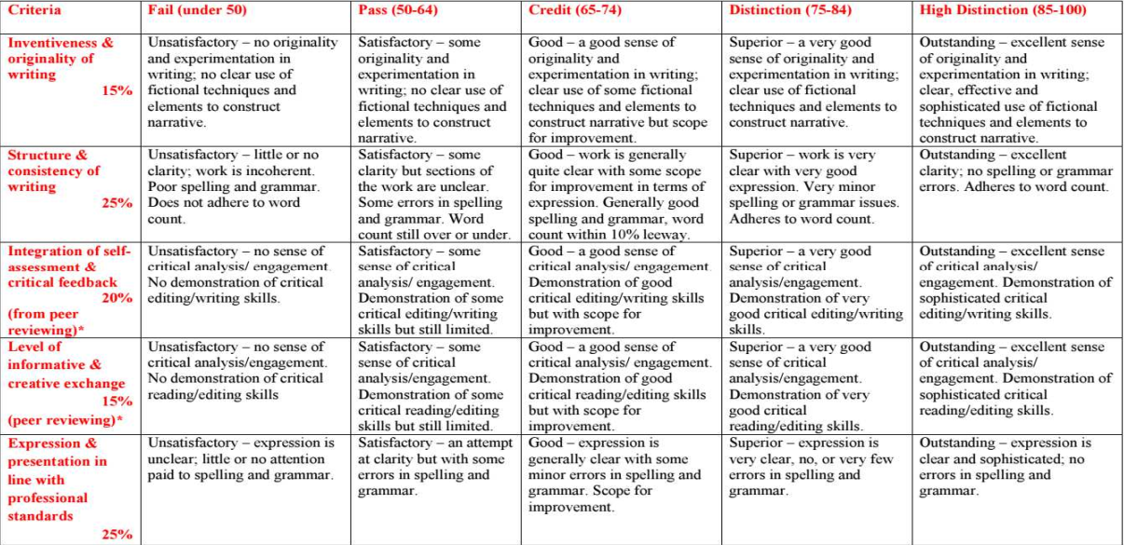
Original rubric
I handed this out:

Slide 14
Co-constructed document

Slide 15
Grade Tiers

Slide 16
CILOs & SLOs

Slide 17
Grading rubric for academics use

Slide 18
Some student comments

Slide 19
Email trail

Slide 20
Thankyou
Dr Sue Joseph
Creative Writing
sue.joseph@uts.edu.au

